Slide 1
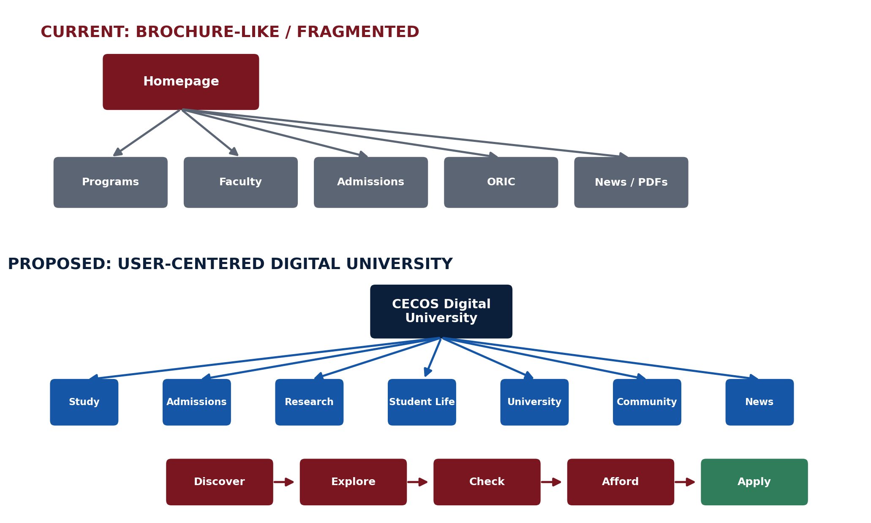
CECOS
UNIVERSITY
Website Research,
Competitive Benchmarking &
Recommended Digital Architecture
A research-led audit of CECOS University’s public web ecosystem, compared with leading Pakistani and international university sites.
FIRST-HAND AUDIT
10-UNIVERSITY BENCHMARK
MVP + INFORMATION ARCHITECTURE
Notes:
Opening: This is not a visual redesign proposal. It is the result of auditing my own university website, benchmarking it against leading universities, and translating the gaps into a measurable digital architecture and MVP.

Slide 2
01 — CORE THESIS
The problem is not a lack of information. It is a lack of information architecture.
CECOS already has academic, research, admission and service assets; the challenge is how those assets are organized, connected and surfaced.
What exists
What is fragmented
What users need
Programs, faculty, admissions, fees, research, careers, policies, portals and student services.
Important details are spread across departments, PDFs, portals, news, forms and separate service pages.
A simple journey: discover → evaluate → understand cost/value → trust the institution → apply.
RESEARCH OUTCOME → restructure the digital university first; redesign the visual interface second.
Source: uploaded research document + official benchmark pages listed in the appendix.
Notes:
Explain the distinction between content volume and information architecture. The research focuses on the latter.

Slide 3
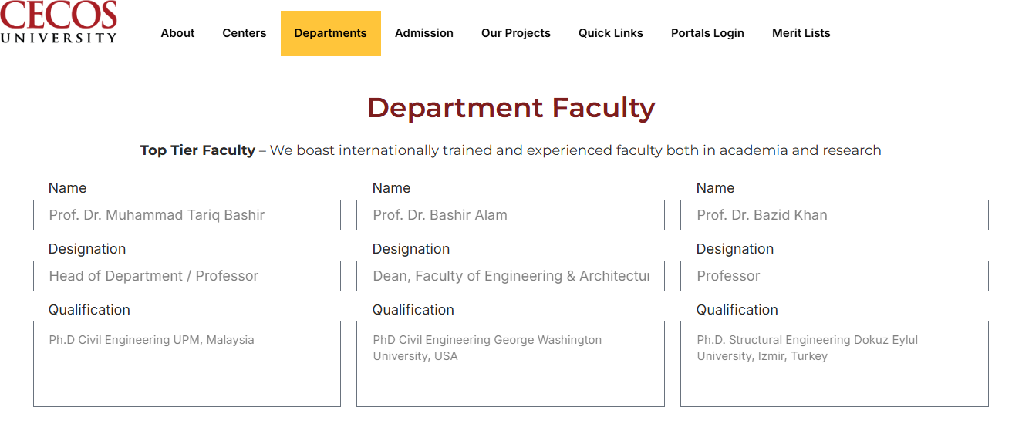
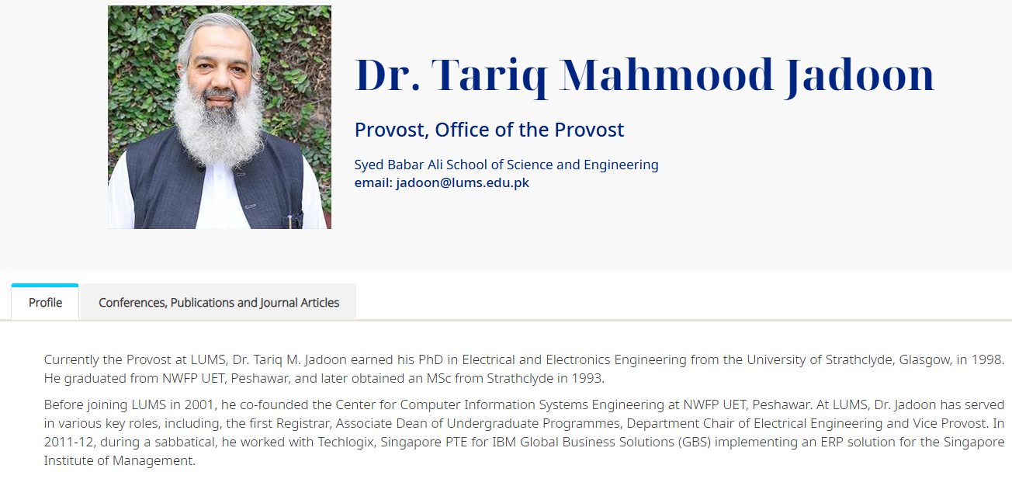
04 — EVIDENCE
Faculty discovery: a high-value trust gap
The research found that CECOS presents useful names/designations, but the academic profile depth and discovery model are much thinner than the benchmark pattern.
CECOS — basic listing / shallow profile layer
LUMS — richer individual academic profile
Gap
Recommendation
Target model
Research identity is not strongly surfaced at the person level.
Searchable faculty entities linked to program, research and publications.
Person → Department → Program → Research → Publications.
Source: user-supplied research document, pp. 1–2; LUMS benchmark pattern.
Notes:
Use the screenshots as evidence, not as a claim that one visual layout automatically causes higher rankings. The actual research point is depth and discoverability of academic entities.

Slide 5
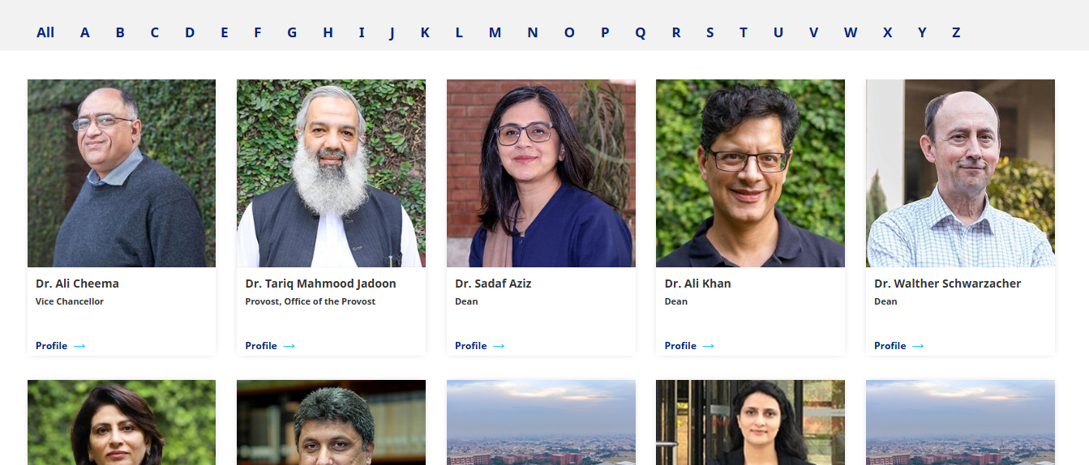
LUMS UNIVERSITY SHOWS THEIR FACULTY

Slide 6
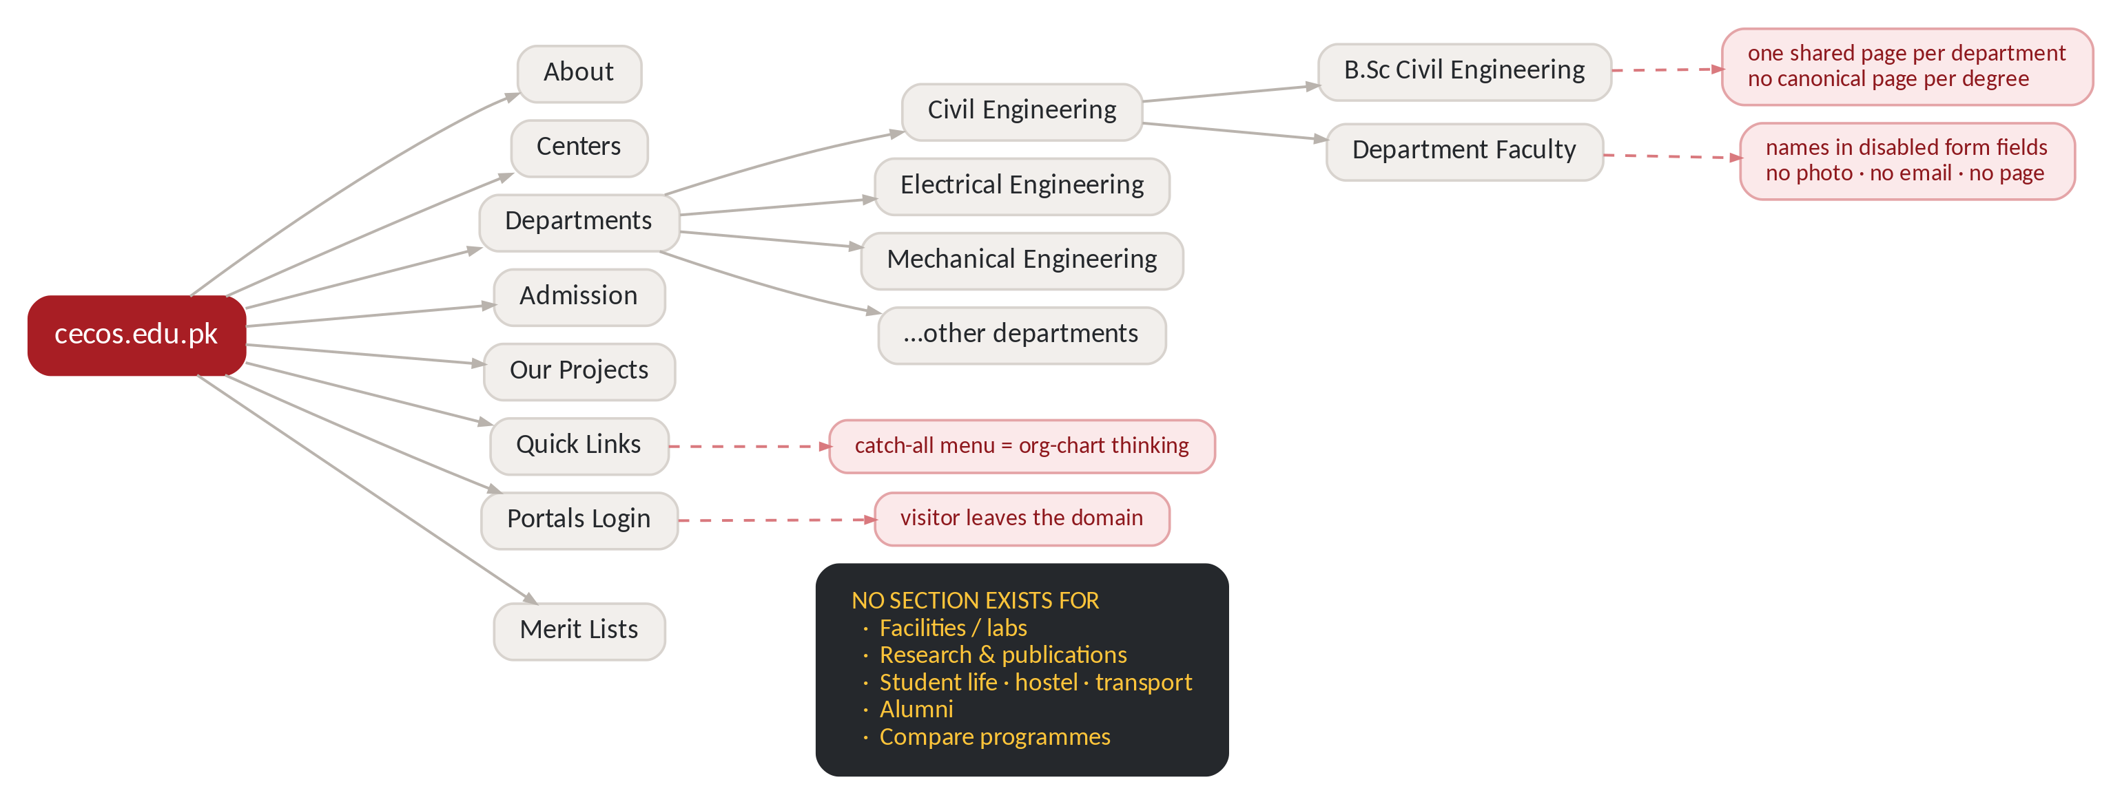
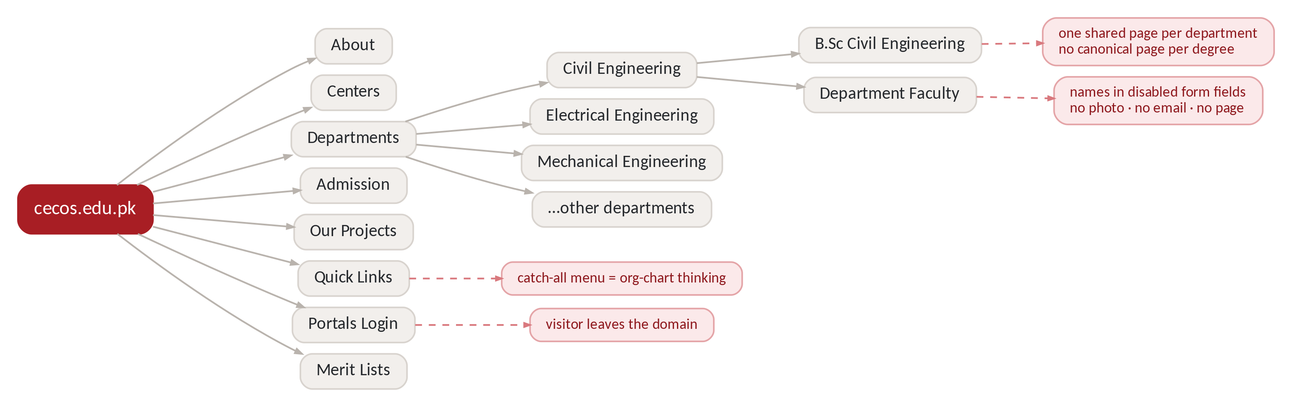

Slide 7
Missing feature: Interactive campus map
The site gives an address and facilities but should give users a real map.
Campus Map
├── Administration
├── Departments
├── Student Support
├── Library
├── Labs
├── Cafeteria
├── Mosque
├── Physiotherapy Clinic
├── Parking

Slide 8
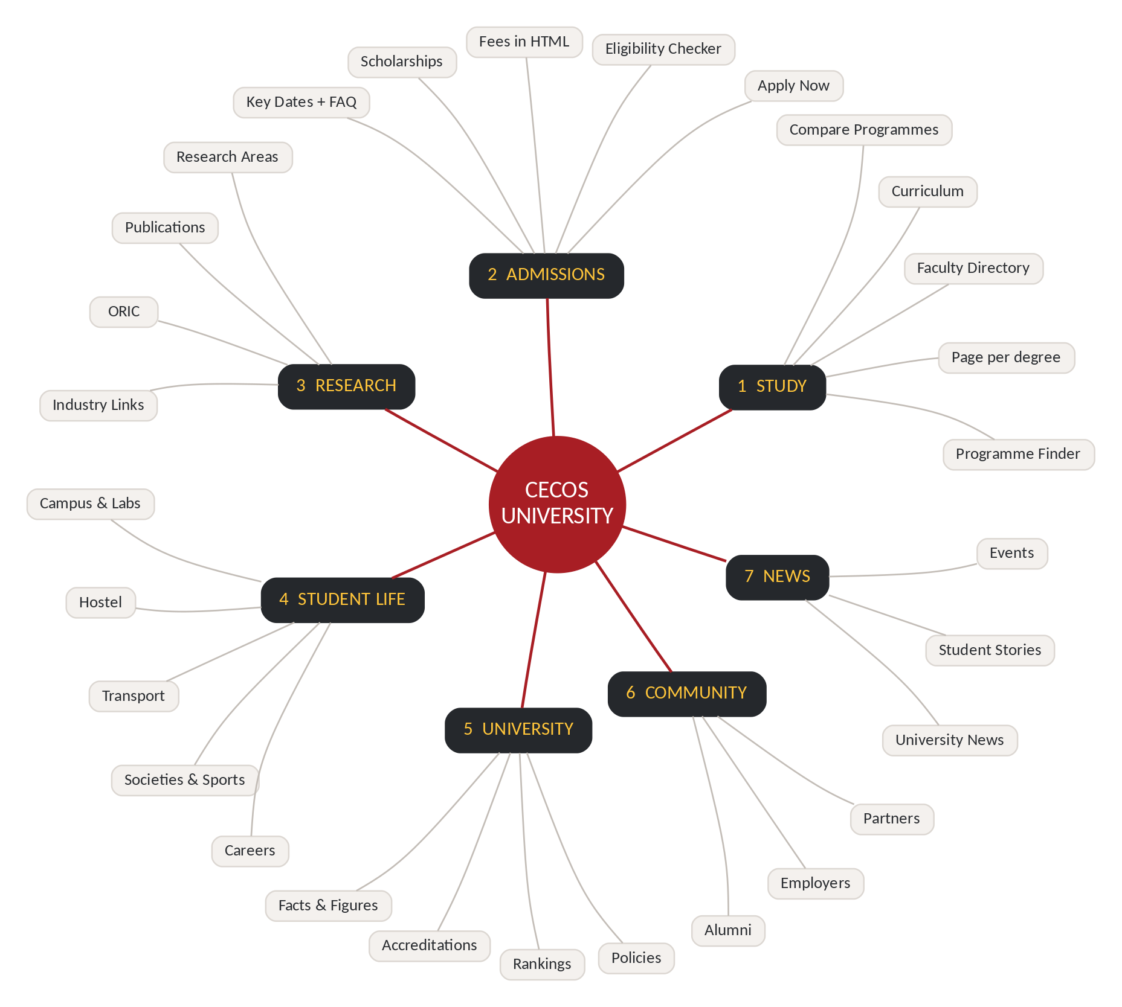

Slide 9
Missing Features to be noted:
Student Projects / FYP Showcase
Display real student projects with problem, solution, technologies, supervisor, students, demo and outcomes to provide evidence of practical learning.
Missing Events & Academic Information
Events & Calendar System
CECOS has event content, but it is fragmented across pages and departments.
Add one searchable calendar with upcoming/past events, registration, speakers, location and event details.
PEOs & PLOs
PEO/PLO information exists, but is not consistently visible across all programs.
Add dedicated PEO, PLO, curriculum and outcome-mapping sections to every relevant program page.
Search & Discovery
Important academic information can be difficult to find quickly.
Add a strong site-wide search covering programs, faculty, policies, research, events and documents.

Slide 10
Missing Policies & Governance Architecture:
Central Policy & Governance Hub
Policies are distributed across departments, QEC, ORIC and other offices.
Create one searchable hub with policy owner, category, version/date and downloadable document.
1. QEC Policy Hub.
2. ORIC Policy Hub
3. PLEC Information & Policy Hub

Slide 11
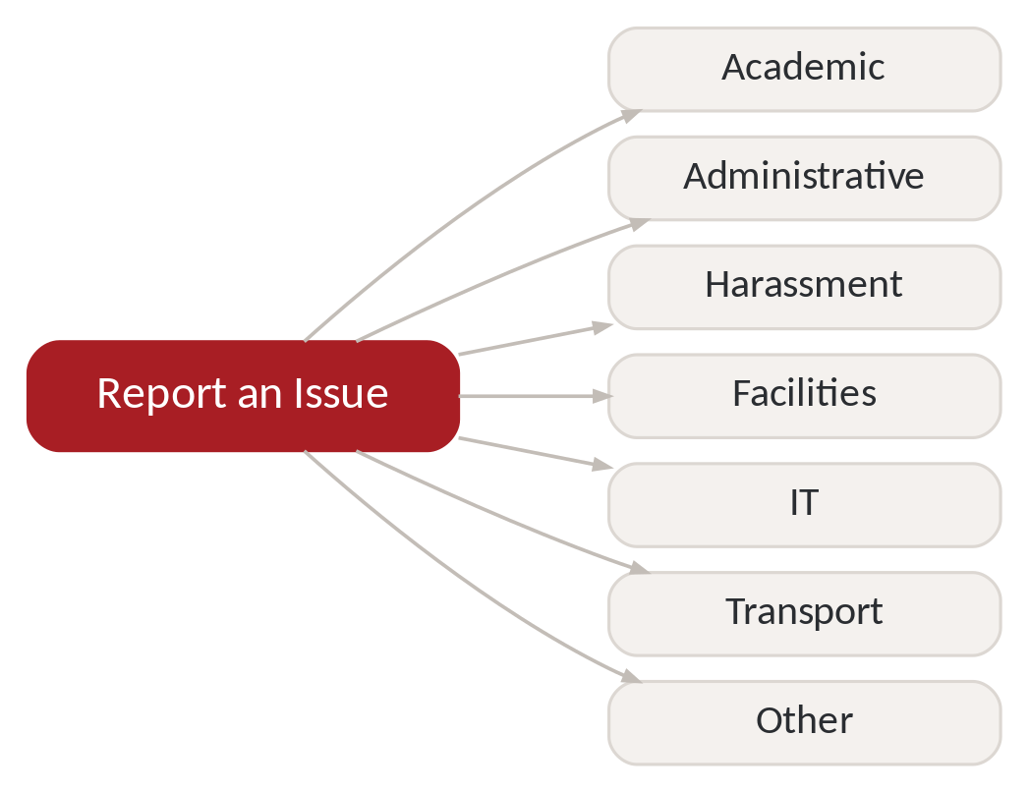
Suggested Changes:

Slide 12
03 — BENCHMARK
The comparison set
I studied five Pakistani and five international universities to extract patterns—not to copy their visual styles.
PAKISTAN
INTERNATIONAL
NUST
MIT
Academics, admissions, research, international, campus life
Academic + research organization, applicant pathways
LUMS
Stanford
Faculty depth, program discovery, applicant information
User-group architecture, academics, research, admissions
COMSATS
Oxford
Programs, research, students, alumni, campuses
Course discovery, requirements, course-centric information
GIKI
Cambridge
Program + admissions visibility, scholarships, campus experience
Course search, fees/funding, student life, international
Habib
Imperial
Admissions guidance, eligibility, applicant support
Step-by-step application, tracking, find-a-course
Sources: official benchmark pages listed in Appendix; comparative synthesis from the research document.

Slide 13
06 — CONVERSION + SEO
Facilities & labs: move from claims to evidence
Engineering and technology applicants want proof of practical learning infrastructure. The research recommends dedicated lab pages with reusable evidence.
Computer Labs
Mechanical Engineering Lab
Photos/video • equipment • software • capacity • timings
Photos/video • equipment • software • capacity • timings
Electrical Engineering Lab
Physics / Chemistry Labs
Photos/video • equipment • software • capacity • timings
Photos/video • equipment • software • capacity • timings
Civil Engineering Lab
Software / Programming Lab
Photos/video • equipment • software • capacity • timings
Photos/video • equipment • software • capacity • timings
Add to every lab page
FACULTY IN-CHARGE
ACCREDITATION / SAFETY
RELATED PROGRAMS
HOSTEL + CAMPUS DETAILS
Source: supplied research document, pp. 6–8.

Slide 14
11 — DIGITAL UNIVERSITY MODEL
Recommended CECOS sitemap
Seven public-facing pillars, plus a persistent digital-services layer.
1. STUDY
2. ADMISSIONS
3. RESEARCH & INNOVATION
4. STUDENT LIFE
5. UNIVERSITY
6. COMMUNITY
7. NEWS & INSIGHTS
Program Finder
Undergraduate / Graduate
Departments
Faculty Directory
Curriculum
Compare Programs
Apply Now
Eligibility Checker
Fees
Scholarships
Important Dates
FAQs
International
Research Areas
Centers / Labs
Researchers
Publications
Projects / Grants
ORIC
Industry Collaboration
Campus / Facilities
Societies
Sports / Events
Library
Hostel / Transport
Support
Careers
About
Leadership
Facts & Figures
Accreditation
Rankings
QEC / Policies
Annual Reports
Alumni
Employers / Industry
Partners
International Partners
Giving
Media
University News
Research News
Student Stories
Alumni Stories
Events
Announcements
PERSISTENT: SEARCH + APPLY NOW + DIGITAL SERVICES
Source: recommended sitemap developed from the supplied research document, pp. 9–13.

Slide 15
13 — PRODUCT BACKLOG
Highest-value features to add
Prioritized around user value, trust, discoverability and measurable conversion.
P0 Program Finder
P0 Program Compare
Find programs by level, discipline, background and intake.
Compare CS / SE / AI by duration, eligibility, fee, labs, faculty, research and careers.
P0 Eligibility Checker
P0 Fee + Scholarship Tools
Turn admission requirements into an interactive decision tool.
Estimate payable cost and match relevant funding/concession categories.
P1 Faculty Profiles
P1 Research Explorer
Person pages with research, publications, education and contact.
Researchers, projects, publications, grants, labs and commercialization.
P1 Facilities & Labs
P1 Student Projects
Evidence-rich lab pages with equipment, photos and related programs.
FYP/capstone showcase with problem, technology, team, supervisor and outcomes.
Future differentiators
AI PROGRAM ADVISOR
AI ADMISSIONS ASSISTANT
RESEARCH EXPLORER
VIRTUAL CAMPUS
Source: feature prioritization in supplied research document and subsequent gap analysis.

Slide 16
15 — MEASUREMENT
How I would prove the project worked
Success is measured through search visibility, discovery, decision quality, conversion, trust, services and technical quality.
SEO
Discovery
Decision
Non-brand impressions
Clicks • Avg. position
Indexed priority pages
Program finder usage
Search usage
Program page entrances
Eligibility checks
Fee / scholarship tool use
Compare usage
Conversion
Trust
Service
Apply clicks
Application starts
Completed applications
Faculty profile views
Research engagement
Lab/facility views
Helpdesk cases
Portal click-through
Results / verification use
Quality layer: broken links • outdated pages • schema validity • Core Web Vitals • data consistency
Source: KPI framework in supplied research document. Exact baselines require CECOS Analytics/Search Console.

Slide 17
16 — DEFENSE
Why this is my research work
This slide is the answer when someone asks: “What exactly did you do?”
I audited my own university
I benchmarked 10 universities
Captured concrete interface/content observations rather than relying on generic web-design advice.
Five Pakistani + five international sites, each studied for a specific pattern.
I identified gaps
I converted findings into a system
Program discovery, faculty depth, research visibility, facilities evidence, fragmented services and search foundations.
Sitemap, user journey, Golden Triangle, features, MVP roadmap and KPI framework.
THE CONTRIBUTION: a research-led product recommendation — restructure the digital university first, then redesign the visual interface.
Source: research contribution and one-line defense from supplied document.
Notes:
This is the key defense slide. Keep the answer simple and confident: audit → benchmark → gap analysis → architecture → MVP → measurement.

Slide 18
